Slide 1
Information Retrieval
Topic- Text Clustering
(K-means clustering)
Lecture-36
Prepared By
Dr. Rasmita Rautray & Dr. Rasmita Dash
Associate Professor
Dept. of CSE

Slide 2
Text Clustering

Slide 3
Content
Clustering
Classification Vs Clustering
Applications of clustering in information retrieval
K-mean Clustering

Slide 4
Clustering: Definition
(Document) clustering is the process of grouping a set of documents into clusters of similar documents.
Documents within a cluster should be similar.
Documents from different clusters should be dissimilar.
Clustering is the most common form of unsupervised learning.
Unsupervised = there are no labeled or annotated data.

Slide 5
Classification vs. Clustering
Classification: supervised learning
Clustering: unsupervised learning
Classification: Classes are human-defined and part of the input to the learning algorithm.
Clustering: Clusters are inferred from the data without human input.
However, there are many ways of influencing the outcome of clustering: number of clusters, similarity measure, representation of documents, . . .

Slide 6
Clustering in IR

Slide 7
The cluster hypothesis
Cluster hypothesis. Documents in the same cluster behave similarly with respect to relevance to information needs.
All applications of clustering in IR are based (directly or indirectly) on the cluster hypothesis.
Van Rijsbergen’s original wording (1979): “closely associated documents tend to be relevant to the same requests”.

Slide 8
Applications of clustering in IR
Application | What is clustered? | Benefit
search result clustering | search results | more effective information Presentation to user
Scatter-Gather | (subsets of) collection | alternative user interface: “search without typing”
collection clustering | collection | effective information presentation for exploratory Browsing
cluster-based retrieval | collection | higher efficiency: faster search

Slide 9
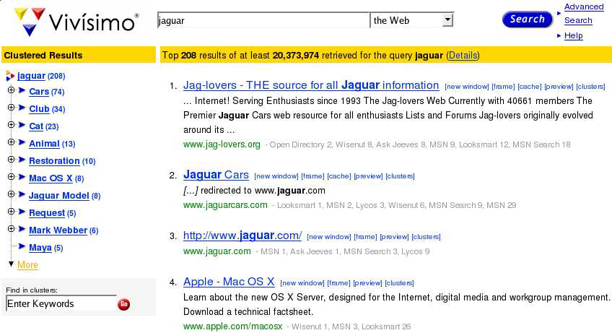
Search result clustering for better navigation

Slide 10
Clustering for improving recall
To improve search recall:
Cluster docs in collection a priori
When a query matches a doc d, also return other docs in the cluster containing d
Hope: if we do this: the query “car” will also return docs containing “automobile”
Because the clustering algorithm groups together docs containing “car” with those containing “automobile”.
Both types of documents contain words like “parts”, “dealer”, “mercedes”, “road trip”.

Slide 11
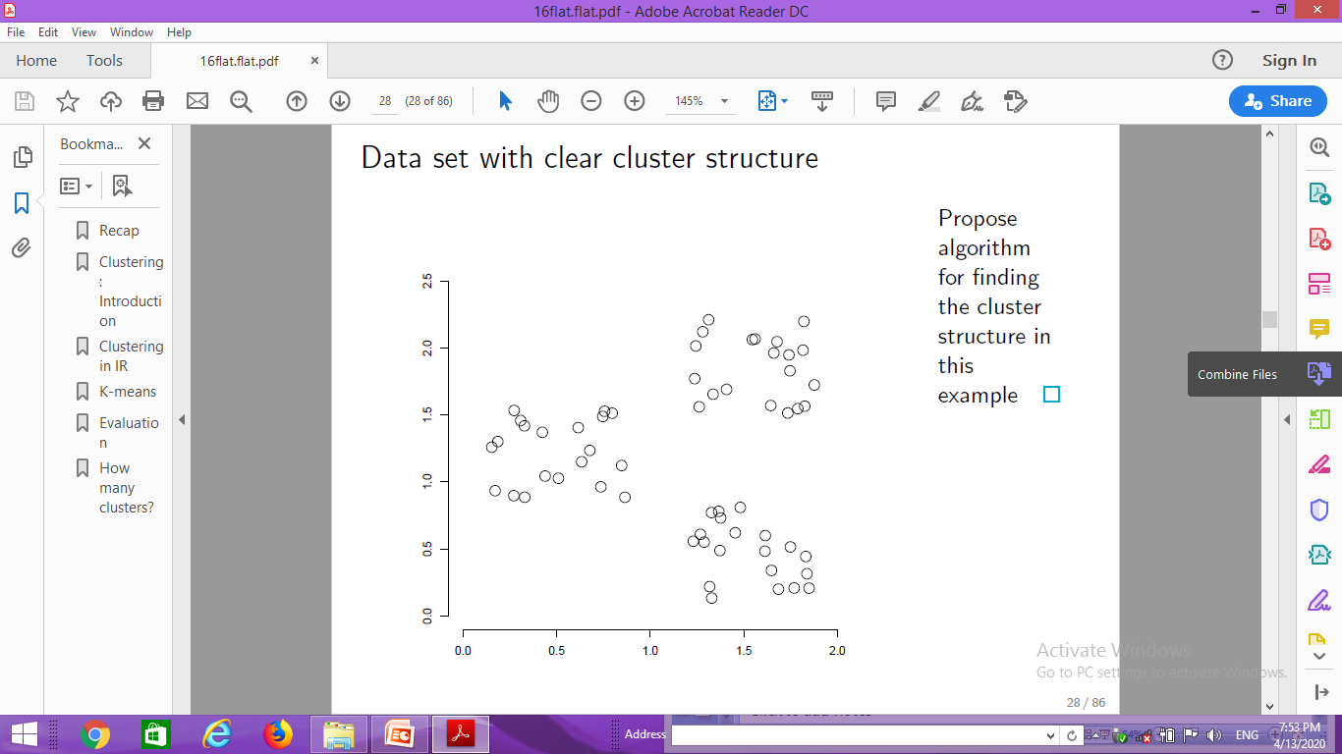
Data set with clear cluster structure
Cluster
structure

Slide 12
Desiderata for clustering
General goal: put related docs in the same cluster, put unrelated docs in different clusters.
We’ll see different ways of formalizing this.
The number of clusters should be appropriate for the data set we are clustering.
Initially, we will assume the number of clusters K is given.
Later: Semiautomatic methods for determining K
Secondary goals in clustering
Avoid very small and very large clusters
Define clusters that are easy to explain to the user
Many others . . .

Slide 13
Flat vs. Hierarchical clustering
Flat algorithms
Usually start with a random (partial) partitioning of docs into groups
Refine iteratively
Main algorithm: K-means
Hierarchical algorithms
Create a hierarchy
Bottom-up, agglomerative
Top-down, divisive

Slide 14
Hard vs. Soft clustering
Hard clustering: Each document belongs to exactly one cluster.
More common and easier to do
Soft clustering: A document can belong to more than one cluster.
Makes more sense for applications like creating browsable hierarchies
You may want to put sneakers in two clusters:
sports apparel
shoes
You can only do that with a soft clustering approach.

Slide 15
Flat algorithms
Flat algorithms compute a partition of N documents into a set of K clusters.
Given: a set of documents and the number K
Find: a partition into K clusters that optimizes the chosen partitioning criterion
Global optimization: exhaustively enumerate artitions, pick optimal one
Not tractable
Effective heuristic method: K-means algorithm

Slide 16
K-means
The best known clustering algorithm
Simple, works well in many cases
Use as default / baseline for clustering documents

Slide 17
Document representations in clustering
Vector space model
As in vector space classification, we measure relatedness
between vectors by Euclidean distance . . .
. . .which is almost equivalent to cosine similarity.
Almost: centroids are not length-normalized.

Slide 18
K-means: Basic idea
Each cluster in K-means is defined by a centroid.
Objective/partitioning criterion: minimize the average squared difference from the centroid
Recall definition of centroid:
where we use ω to denote a cluster.
We try to find the minimum average squared difference by iterating two steps:
reassignment: assign each vector to its closest centroid
recomputation: recompute each centroid as the average of the vectors that were assigned to it in reassignment

Slide 19
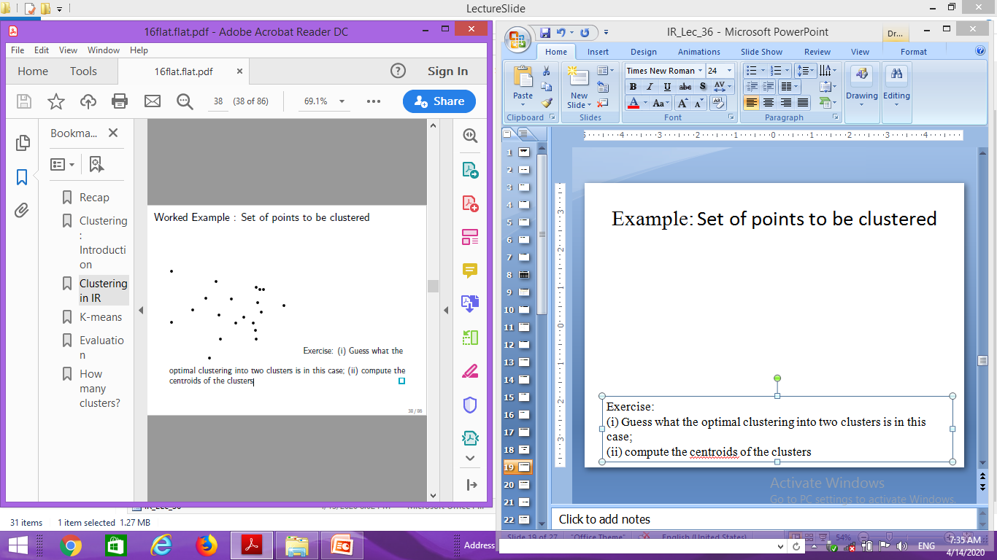
Example: Set of points to be clustered
Exercise:
(i) Guess what the optimal clustering into two clusters is in this case;
(ii) compute the centroids of the clusters

Slide 20
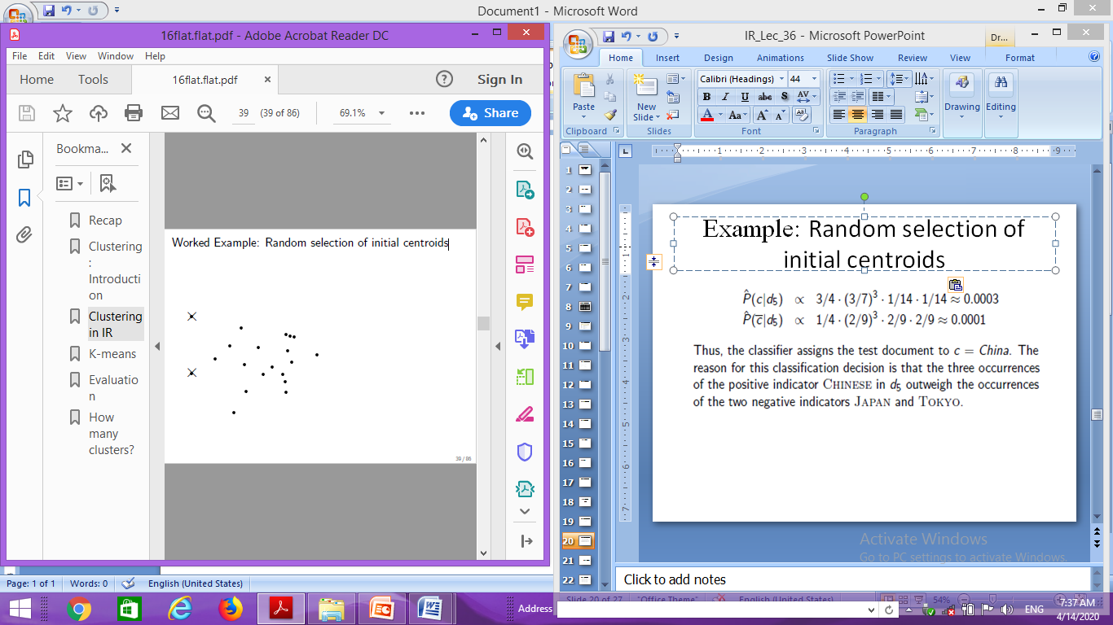
Example: Random selection of initial centroids

Slide 21
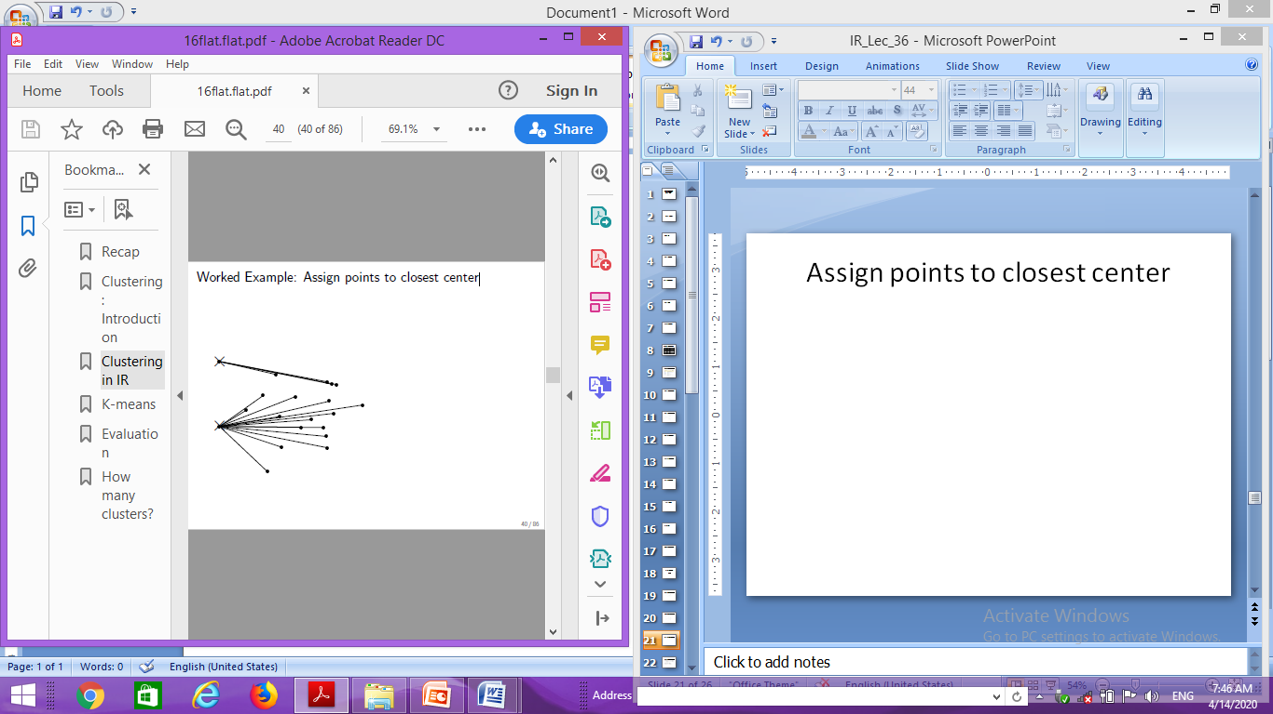
Example: Assign points to closest center

Slide 22
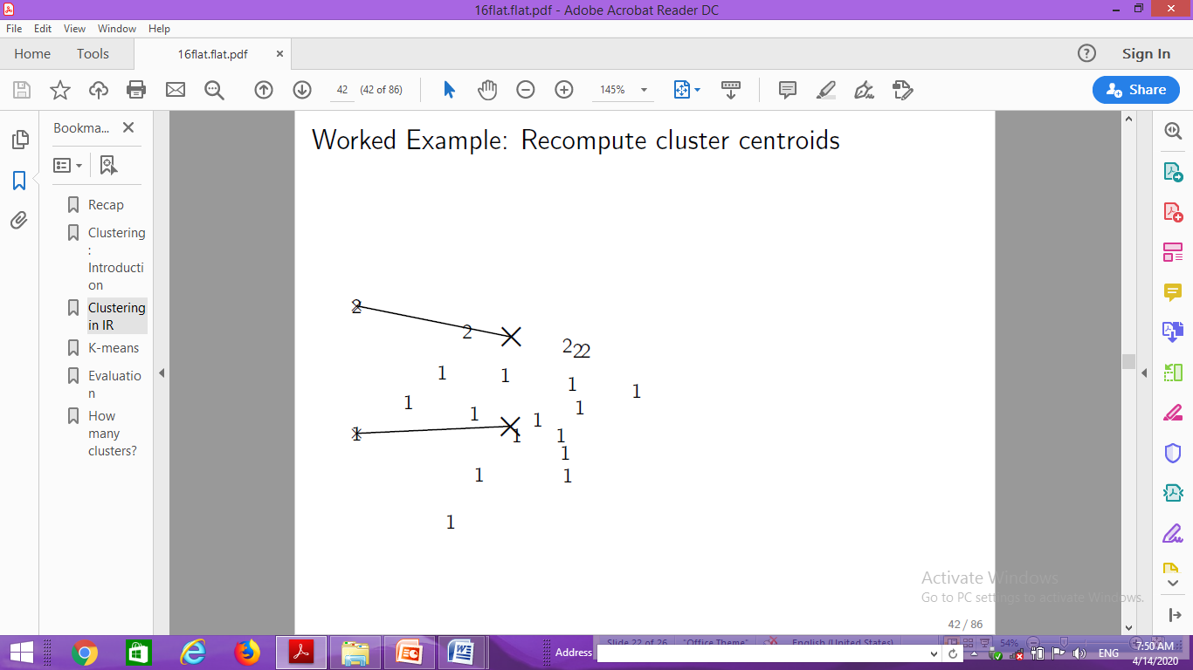
Example: Recompute cluster centroids

Slide 23

Example: Assign points to closest centroid

Slide 24
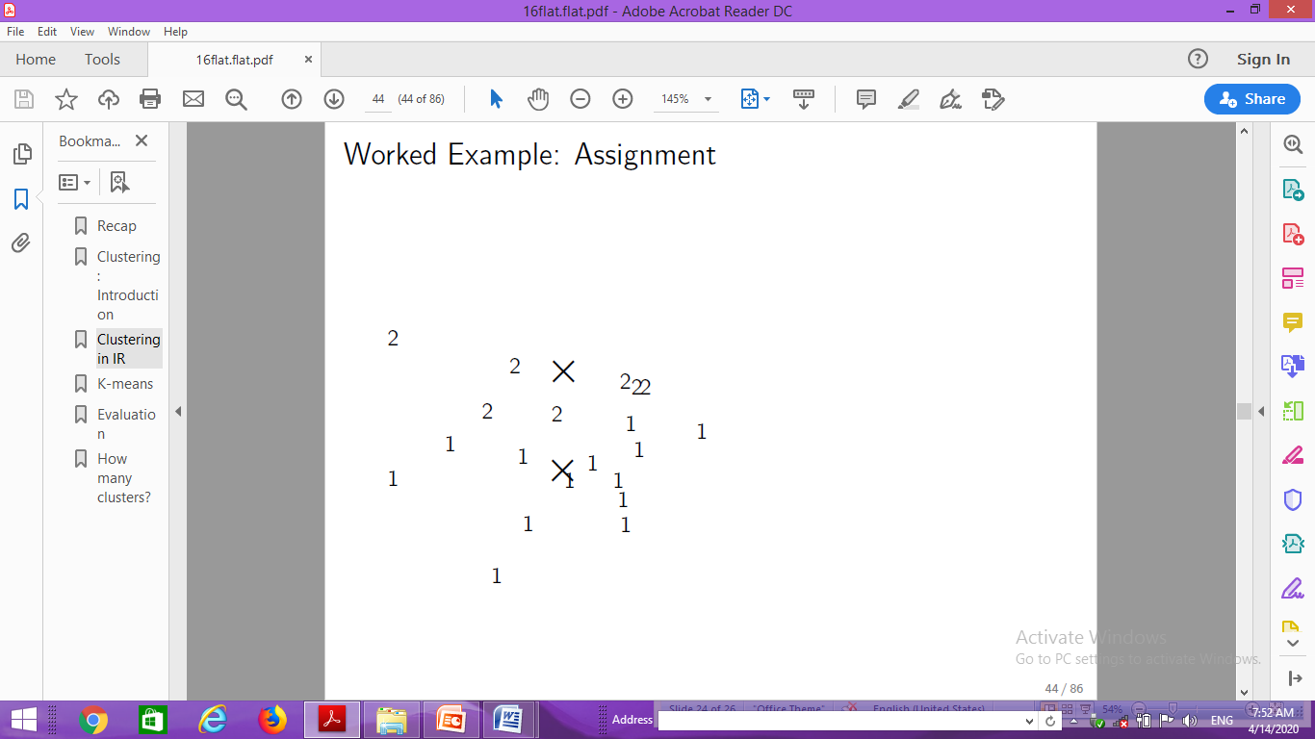
Example: Assignment

Slide 25

Example: Recompute cluster centroids

Slide 26
…

Slide 27

Example: Recompute cluster centroids

Slide 28

Example: Centroids and assignments after convergence

Slide 29
Thank You

